Slide 1

Analyzing University Guidelines on generative AI
Ritesh Verma
Vipul Sarode

Slide 2
Introduction
Analyzing University guidelines on the use of AI tools
Find out major concerns of universities when working with AI.
Find out if a university encourages or discourages the use of AI.
Find out which universities extensively focuses on data privacy and security.
Find out the universities implementing strong ethics on AI usage

Slide 3
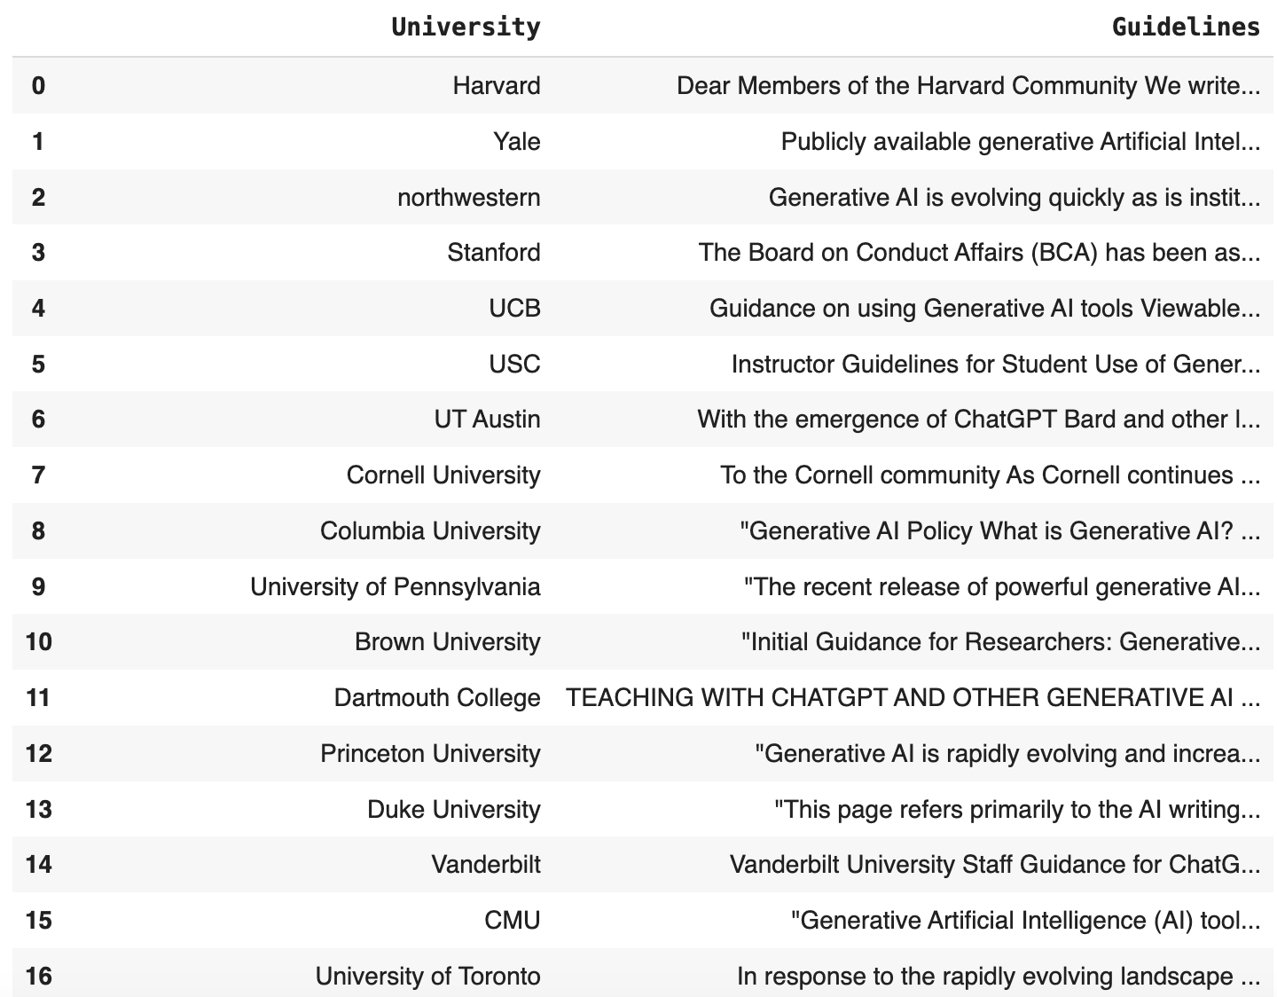
Dataset

Slide 4
Topic Modelling

Slide 5
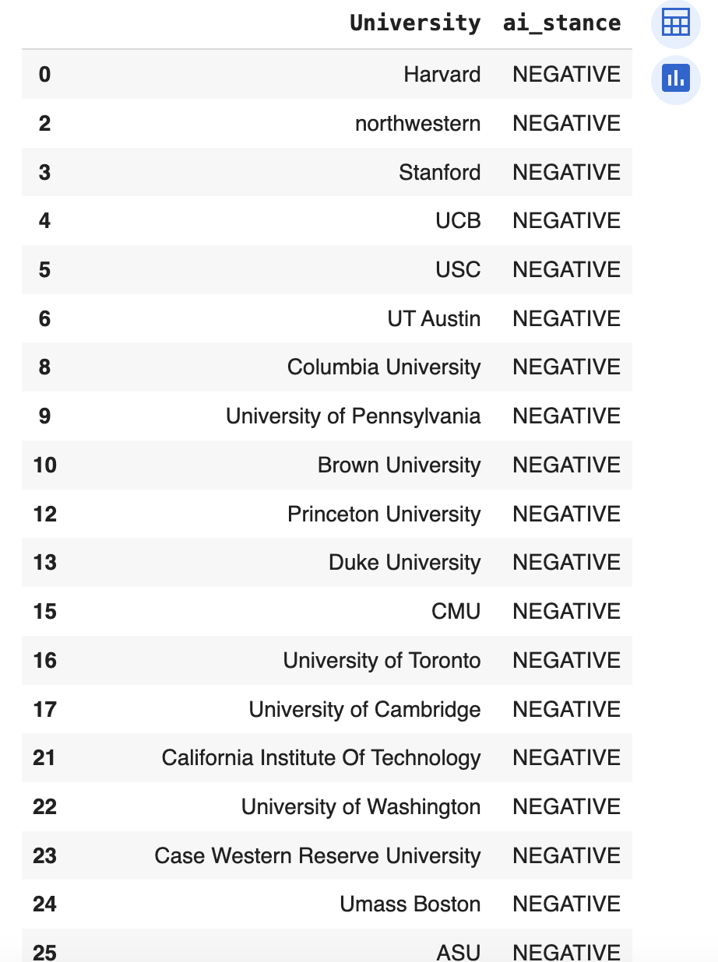
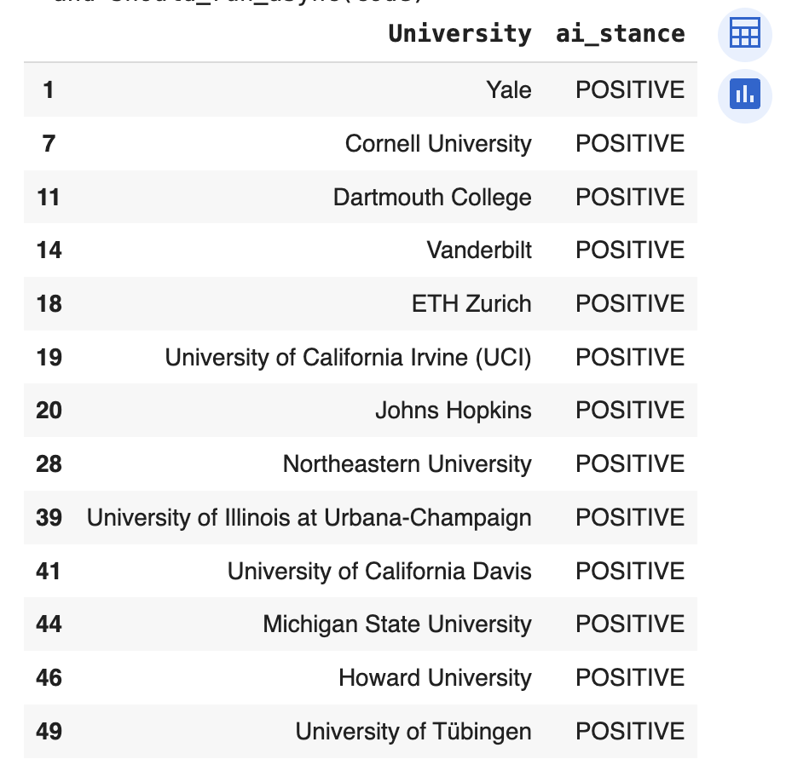
Sentiments of Universities towards AI

Slide 6
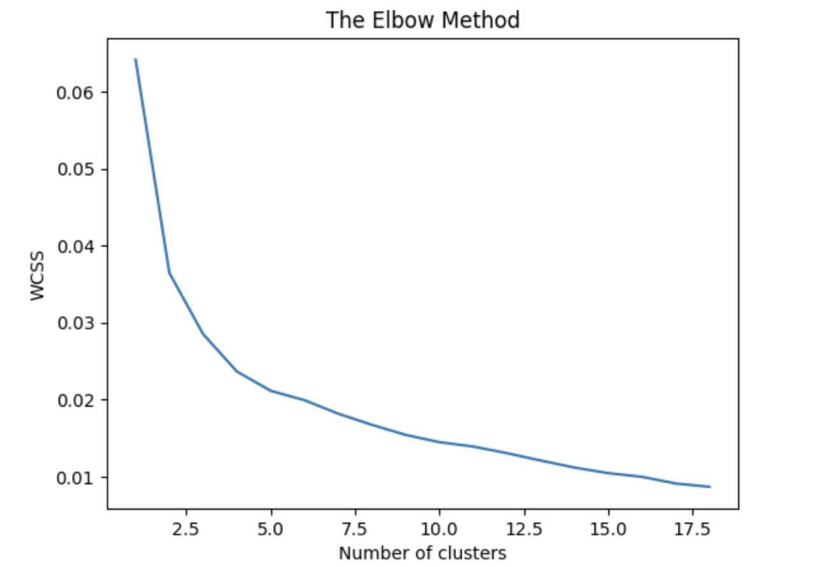
Clustering Analysis
Selected the number of clusters to be 5

Slide 7
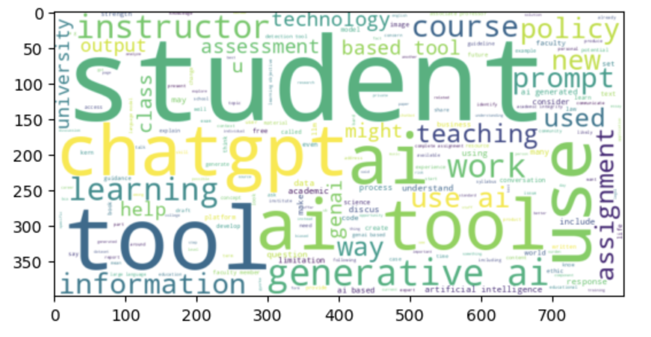
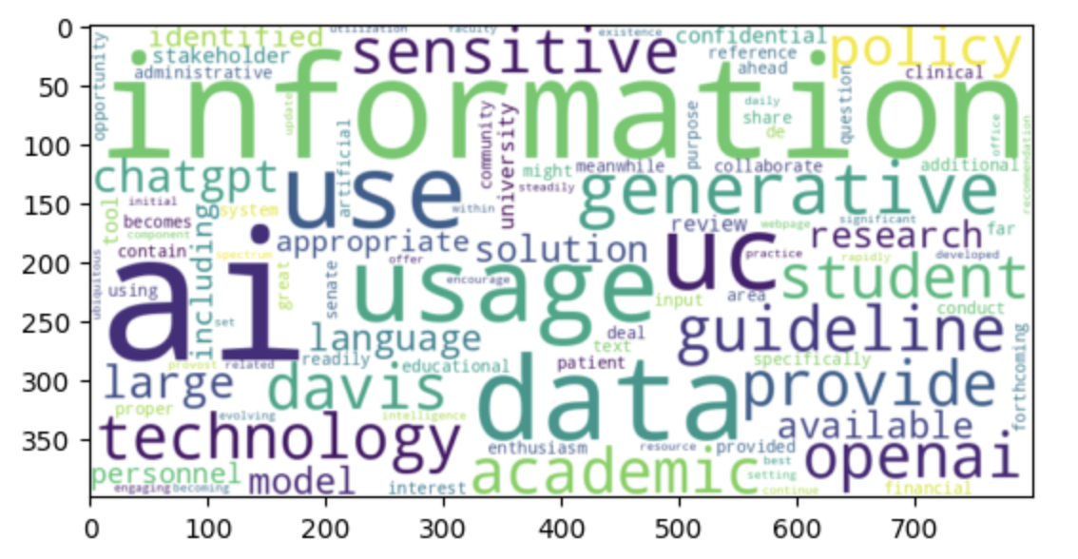
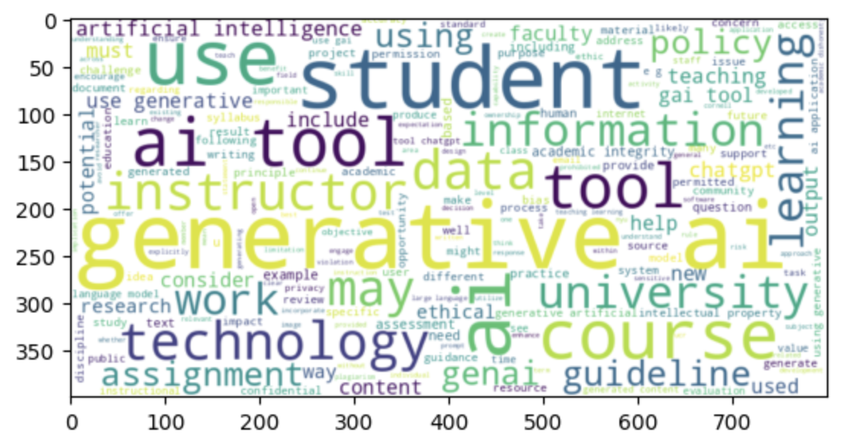
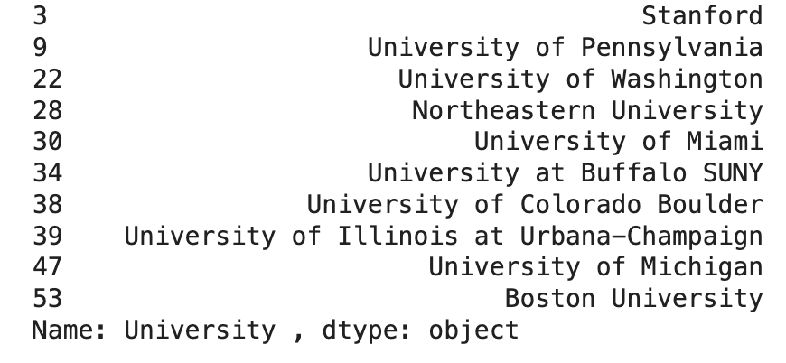
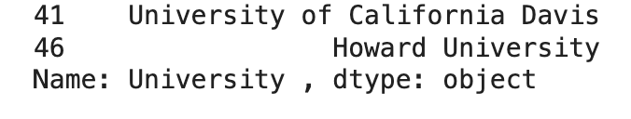
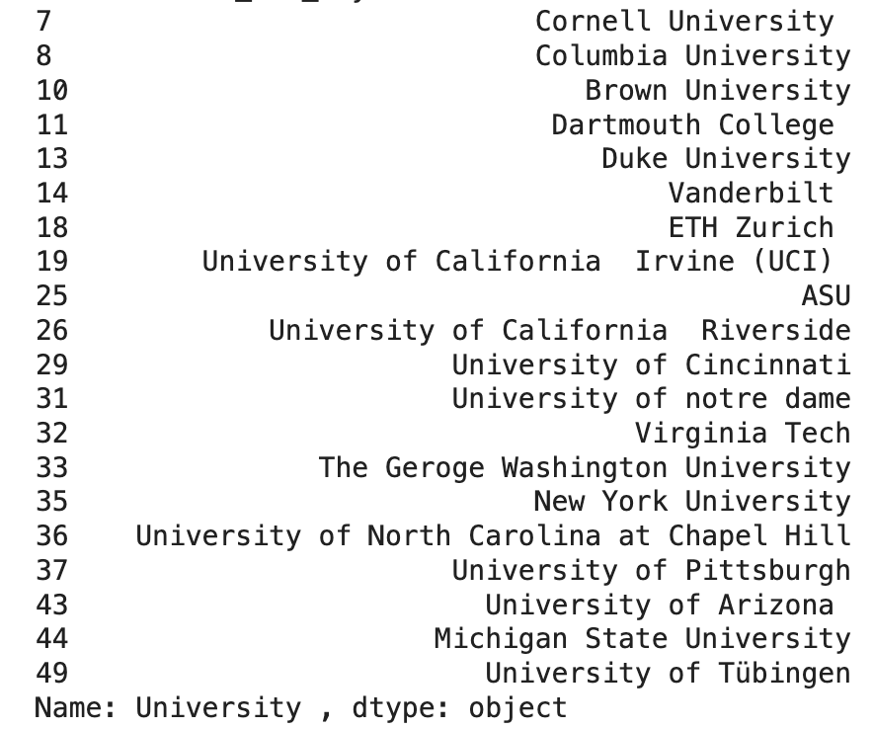

Slide 8
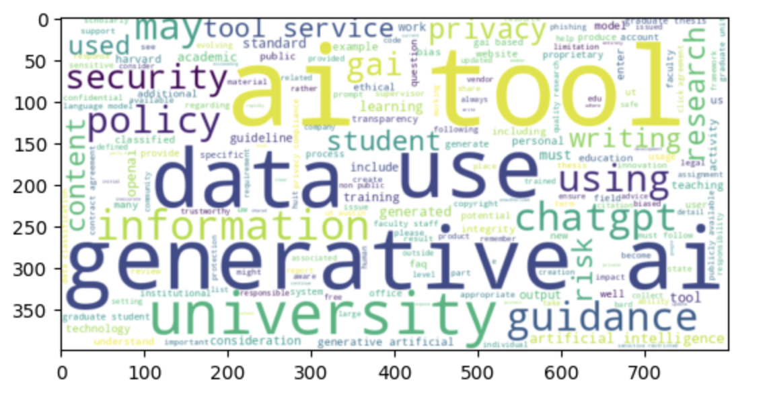
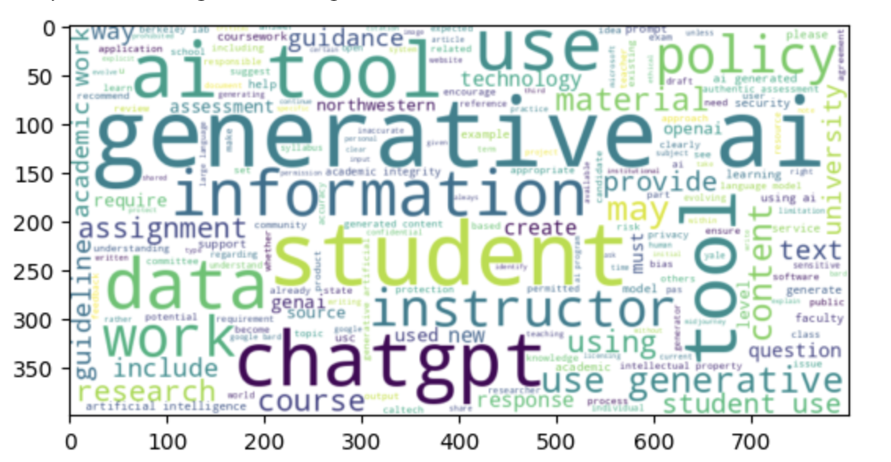
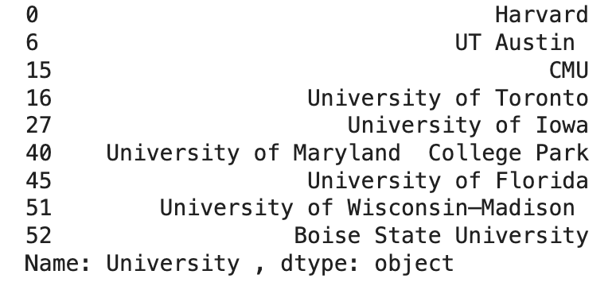
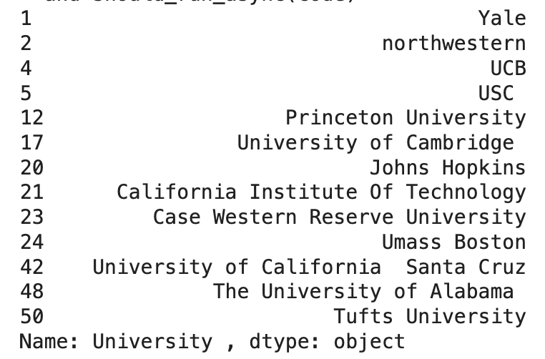

Slide 9
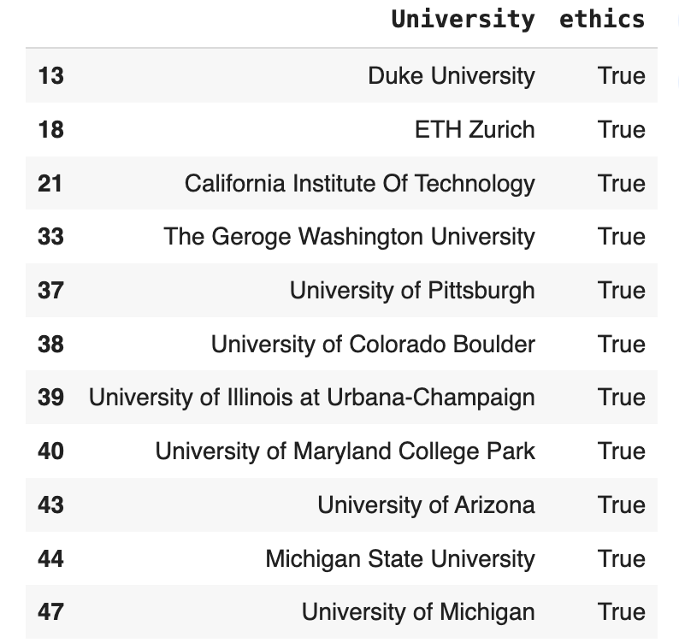
University Ethics in AI usage

